Slide 1

Samsung PRISM Mid Review Report
AUDIO CLASSIFICATION-1
Team
College Professor(s): Dr. Dakshayini M. , Vivek Singhal
Students:
Deeksha Manjunath
Meghana Reddy
Sunag P.
Nupur Thakur
Department: B.M.S. College of Engineering
Date: 26th Feb 2019

Slide 2


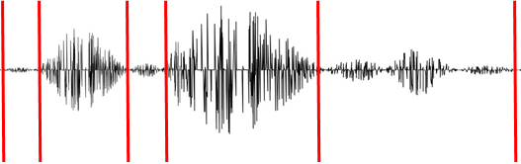
Audio Classification - 1
TM
[ Problem Statement ]
[ Expectations/KPI ]
3
4
Given a audio clip, identify the audio classes in that clip
There could be multiple audio classes in the audio clip. Identify all of them along with timestamp.
Model :- Single Classification model which classifies audio sample.
Targetted classes – Inside Small room, Inside Big room, Outside, Traffic, Conversation, Narration/Monologue, Kid Speech, Kid Singing, Silence, Background noise
Input: Audio samples <sample may contain none of the targeted classes or may be >=1 of the targeted classes>.
Output: Audio classes along with the confidence score & its corresponding time stamp in the audio clip.
Members
Months
Tensorflow based model should run on android mobile phone.
Per class precision - >= 0.90
Inference time for a 1 sec audio buffer (PCM data) < 15 msecs.
OnDevice Model size < 5 MB.
Entire solution should use < 30MB RAM
[ Trainings ]
[ Output ]
Audio domain expertise
Good hands on in Deep learning development frameworks like Tensorflow.
ML understanding,
Model development, training and inference on CPU and GPU
OnDevice AI model
Sample Android application to demonstrate expected functionalities
Meet the expected KPI for ROM, RAM and performance
More Info:
Audio sample can be any audio file OR audio from video file.
Kid Speech - .92
Inside Small Room – 0.75
Conversation - 0.95 Inside Small Room – 0.83
Background Noise – 0.96
Outside – 0.88
Silence – 0.44
[ Timeline ]
Silence – 0.94
00:20
00:30
00:02
00:08
00:10
Kick Off: TBD
Milestone 1: TBD
Milestone 2: TBD
Closure: TBD
For more details contact :-
Detailed problem elicitation
Detailed schedule planning
Align development setup and information/code sharing
Model on PC meeting Accuracy needed for real use case scenarios.
OnDevice AI model meeting the required KPIs for performance, Accuracy, ROM & RAM
Demo Android App
Code / Dataset & all project artefacts shared
Detailed Tech guide
Punuru Srilakshmi, Staff Engineer
srilakshmi.p@samsung.com
+91-9538121188
Karthik CR, Staff Engineer
Karthik,.cr@samsung.com
+91-9164227799
Praveen BP, Staff Engineer (II)
bp.praveen@samsung.com
+91-9880041702

Slide 3
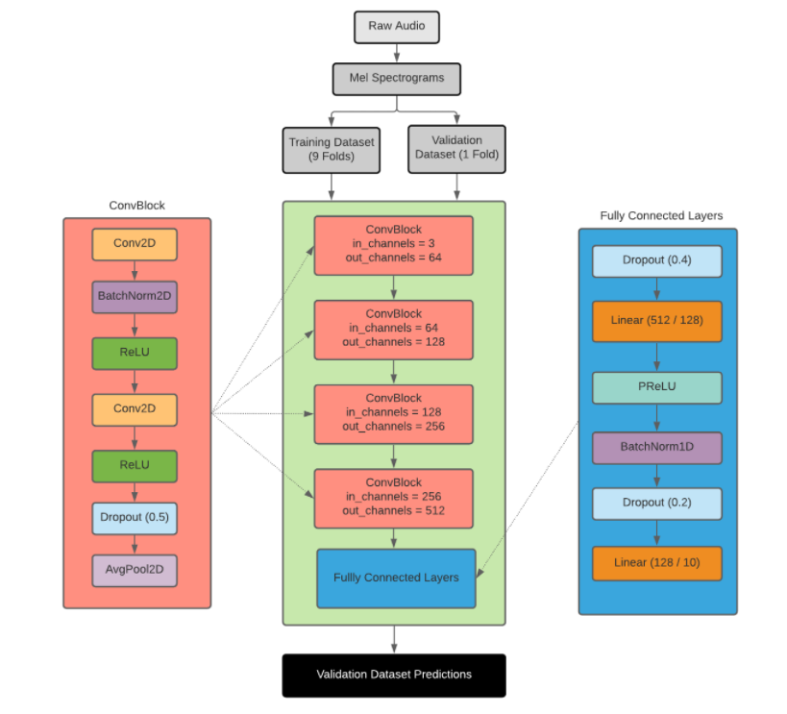
Proposed Approach / Solution
Concept Diagram :

Slide 4
Dataset(s) Analysis / Description
Dataset Capture / Preparation / Generation :
Dataset has been extracted from FSD50K . FSD50K is an open dataset of human-labeled sound events . The dataset has a wide range of Multi-labelled audio files.
https://zenodo.org/record/4060432
We extracted 4 classes from the required targeted classes which include Conversation, Traffic, Kid Speech and Background noise
Dataset Understanding / Analysis :
The extracted dataset was found to be multi-labelled
We extracted more than 100 audio files for each of the classes mentioned above
All the audio files of different classes was manually verified and the audio files inappropriate data was discarded
The average duration of the audio files were found to be 3s (ranging from 1s to 5s)
Dataset Pre-Processing / Related Challenges (if any) :
Imbalance in audio files for different classes – solution: Data Augmentation
Equalising the duration of the audio files

Slide 5
Data/Code Details
Data/Code details:
Parameter | Details
KLOC [Lines of Code in Thousands] | [ 0.6]
Model /Algorithm Details | [ approved CNN Algorithm ]
Details of Datasets uploaded [No of files – Images, Videos, etc.] | [ No. of Audio files obtained : 850 ]
List of Reports Uploaded [Name of All Documents uploaded | [ xx ]

Slide 6
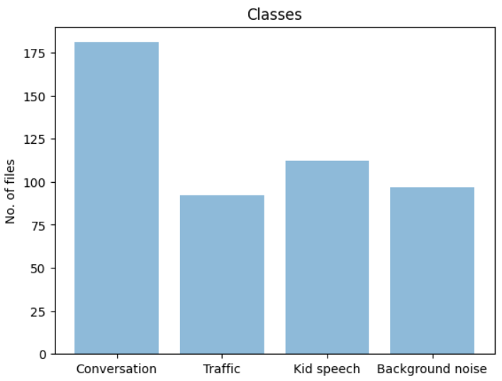
Experimental Results / Simulations / Observations
Results/ Major Observations / Conclusions :
Currently obtained dataset is completely processed
Challenge: To find dataset for rest of the classes
The python package used for audio processing include librosa and soundfile
Approach for training model:
Obtaining the spectrogram of each of the audio files to visualize how the spectrum of an audio signal varies over time
spectrogram is obtained by finding Short-time Fourier transform (STFT)
generating the Mel spectrogram
developing a CNN to classify our sound files using their respective Mel spectrograms

Slide 7
Further Plan to Complete Project
Final Probable Deliverables :
Find dataset for other classes
Training the model with available dataset
Deploy it to android mobile phones

Slide 8
Further Plan to Complete Project
Completion Plan:
Week 1 to 2
Step 1 Training the model using approved CNN algorithm
Week 2 to 4
Step 1 Training the model , increasing the accuracy
Week 5 to 6
Step 1 converting the model to Tensorflow lite and reducing the size of the model if required
Week 7 to 8
Step 1 making the model to run on android mobiles
Challenges Anticipated:
To increase the accuracy due to lesser no. of dataset available
Reducing the size of the model (if required)
Building the model to run on android

Slide 9
Thank you

